Slide 1
What is backpropagation?
Training a neural network typically happens in two phases-
Forward Pass: We compute the outputs of every node in the forward pass and calculate the final loss of the network.
Backward Pass: We start at the end of the network, backpropagate or feed the errors back, recursively apply chain rule to compute gradients all the way to the inputs of the network and then update the weights. This method of backpropagating the errors and computing the gradients is called backpropagation.

Slide 2
It is a very popular neural network training algorithm as it is conceptually clear, computationally tractable and produces optimal results in general.
To reiterate, the aim of a typical neural network problem is to discover a model that fits our data ‘best’.
Ultimately, we want to minimize the cost or loss function by choosing the best set of parameters.

Slide 3
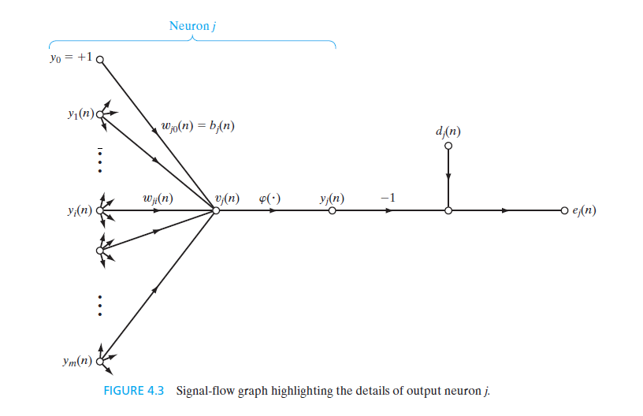

Slide 4
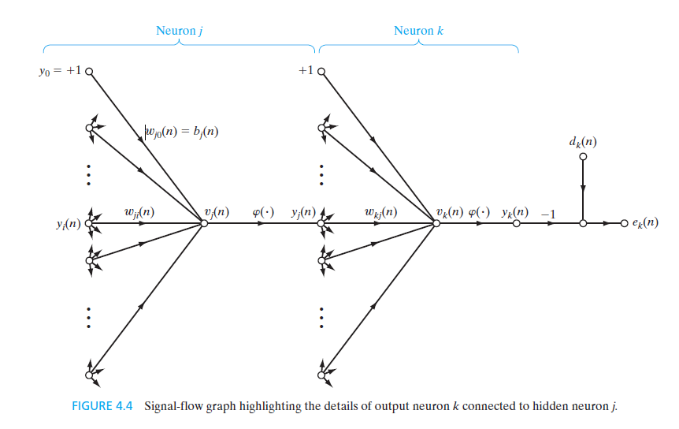

Slide 5
